Slide 1
Excepted from HSRP 734:
Advanced Statistical Methods
June 5, 2008

Slide 2
Introduction
Logistic regression is a form of regression analysis in which the outcome variable is binary or dichotomous
General theory: analysis of variance (ANOVA) and logistic regression all are special cases of General Linear Model (GLM)

Slide 3
What is Logistic Regression?
In a nutshell:
A statistical method used to model dichotomous or binary outcomes (but not limited to) using predictor variables.
Used when the research method is focused on whether or not an event occurred, rather than when it occurred (time course information is not used).

Slide 4
What is Logistic Regression?
What is the “Logistic” component?
Instead of modeling the outcome, Y, directly, the method models the log odds(Y) using the logistic function.

Slide 5
What is Logistic Regression?
What is the “Regression” component?
Methods used to quantify association between an outcome and predictor variables. Could be used to build predictive models as a function of predictors.

Slide 6
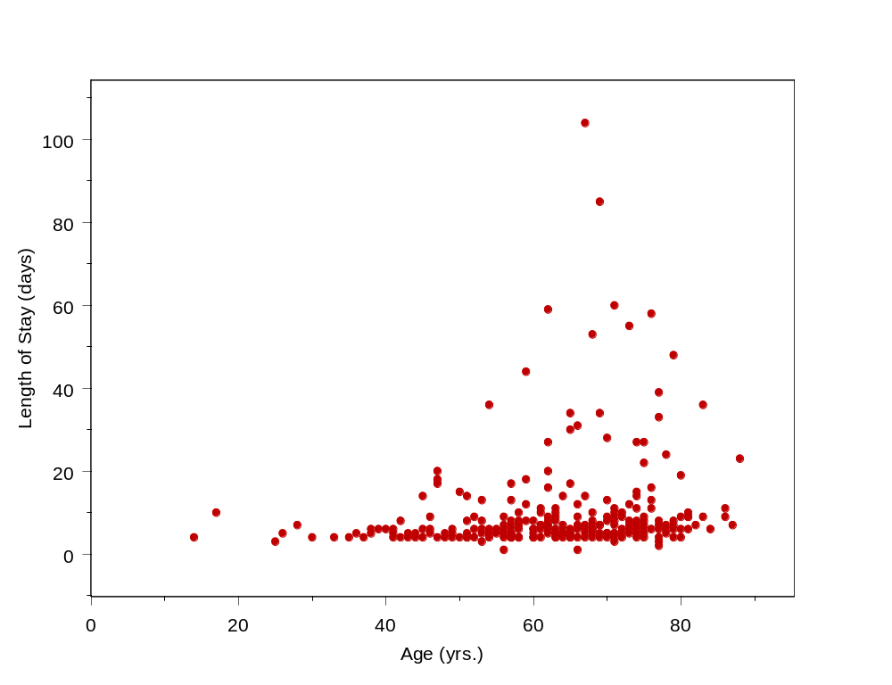
What is Logistic Regression?
element.innerHTML =
newHTML;

Slide 7
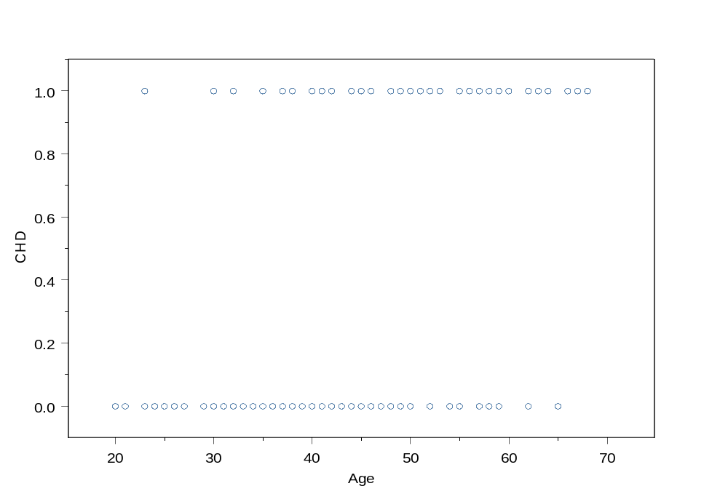
What is Logistic Regression?
100 day Mortality (Died=1, Alive=0)
Age (yrs.)

Slide 8
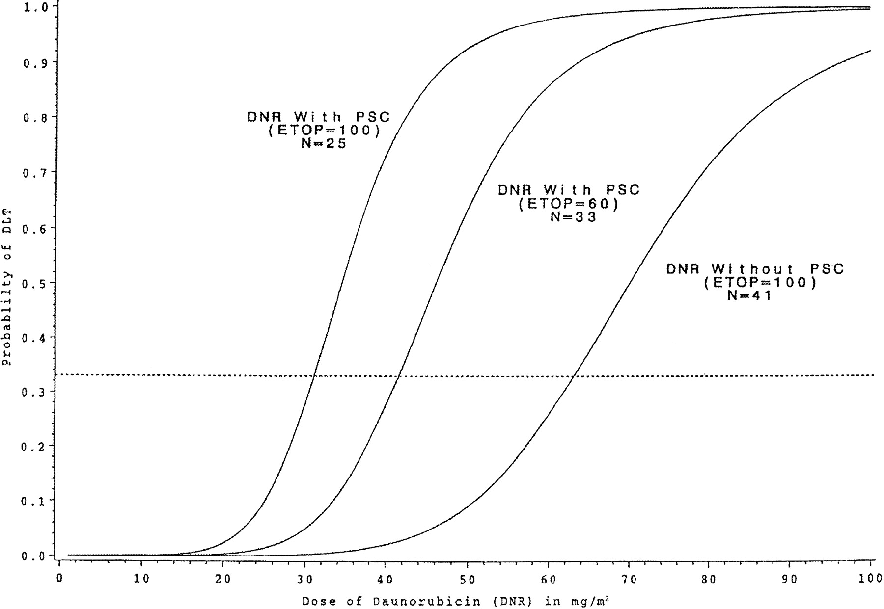
Fig 1. Logistic regression curves for the three drug combinations. The dashed reference line represents the probability of DLT of .33. The estimated MTD can be obtained as the value on the horizontal axis that coincides with a vertical line drawn through the point where the dashed line intersects the logistic curve. Taken from “Parallel Phase I Studies of Daunorubicin Given With Cytarabine and Etoposide With or Without the Multidrug Resistance Modulator PSC-833 in Previously Untreated Patients 60 Years of Age or Older With Acute Myeloid Leukemia: Results of Cancer and Leukemia Group B Study 9420” Journal of Clinical Oncology, Vol 17, Issue 9 (September), 1999: 283. http://www.jco.org/cgi/content/full/17/9/2831

Slide 9
What can we use Logistic Regression for?
To estimate adjusted prevalence rates, adjusted for potential confounders (sociodemographic or clinical characteristics)
To estimate the effect of a treatment on a dichotomous outcome, adjusted for other covariates
Explore how well characteristics predict a categorical outcome

Slide 10
History of Logistic Regression
Logistic function was invented in the 19th century to describe the growth of populations and the course of autocatalytic chemical reactions.
Population growth was described easiest by exponential growth but led to impossible values
Logistic function was the solution to a differential equation that was examined from trying to dampen exponential population growth models.

Slide 11
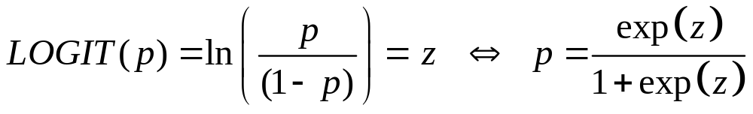
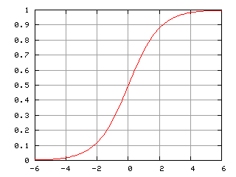


The Logistic Curve
p (probability)
z (log odds)

Slide 12
Logistic Regression
Simple logistic regression = logistic regression with 1 predictor variable
Multiple logistic regression = logistic regression with multiple predictor variables
Multiple logistic regression =
Multivariable logistic regression =
Multivariate logistic regression

Slide 13
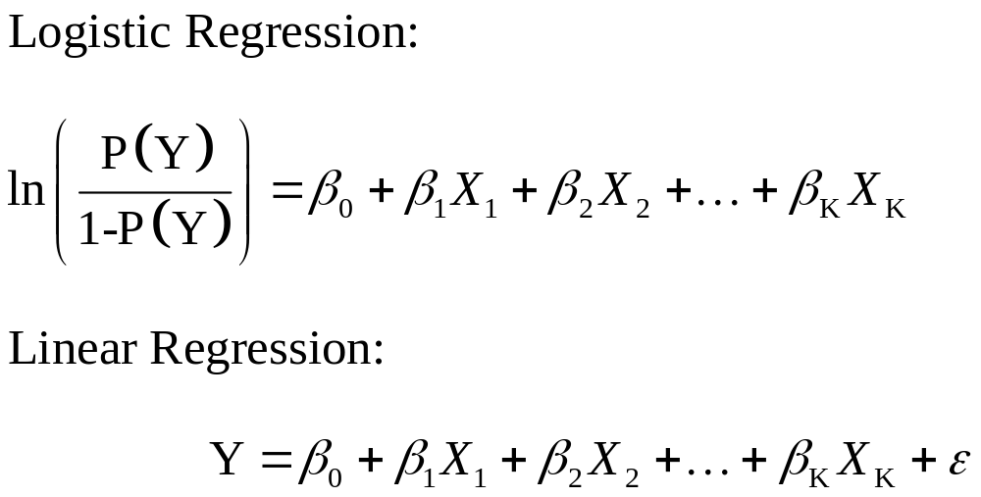
The Logistic Regression Model

Slide 14
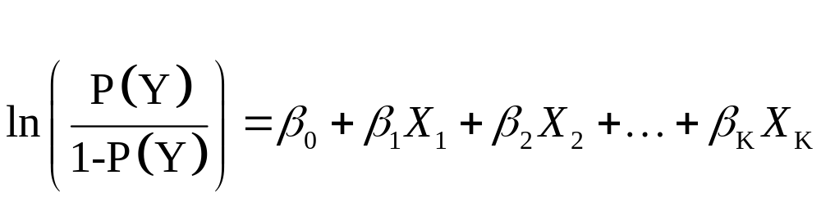
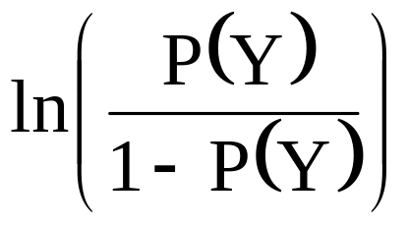
The Logistic Regression Model
predictor variables
dichotomous outcome
is the log(odds) of the outcome.

Slide 15
The Logistic Regression Model
intercept
model coefficients
is the log(odds) of the outcome.

Slide 16
Logistic Regression uses Odds Ratios
Does not model the outcome directly, which leads to effect estimates quantified by means (i.e., differences in means)
Estimates of effect are instead quantified by “Odds Ratios”

Slide 17
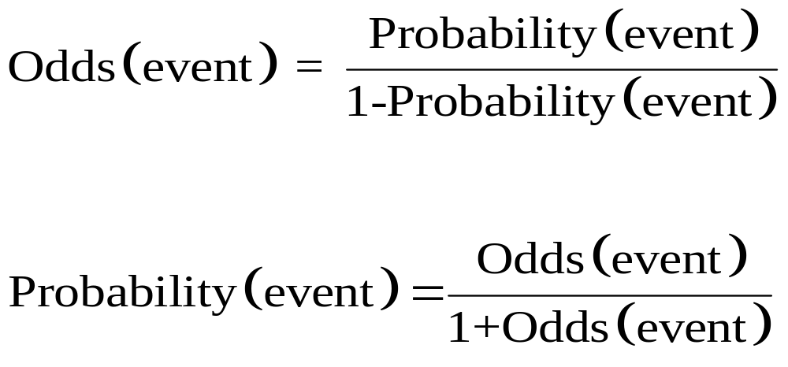
Relationship between
Odds & Probability

Slide 18
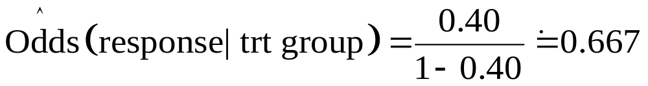
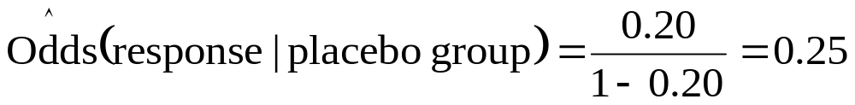
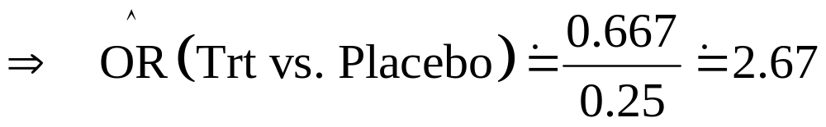
The Odds Ratio
Definition of Odds Ratio: Ratio of two odds estimates.
So, if Pr(response | trt) = 0.40 and Pr(response | placebo) = 0.20
Then:

Slide 19
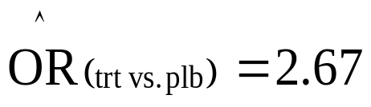
Interpretation of the Odds Ratio
Example cont’d:
  Outcome = response,
Then, the odds of a response in the treatment group were estimated to be 2.67 times the odds of having a response in the placebo group.
Alternatively, the odds of having a response were 167% higher in the treatment group than in the placebo group.

Slide 20
Odds Ratio vs. Relative Risk
An Odds Ratio of 2.67 for trt. vs. placebo does NOT mean that the outcome is 2.67 times as LIKELY to occur.
Why not???
It DOES mean that the ODDS of the outcome occurring are 2.67 times as high for trt. vs. placebo.

Slide 21
Odds Ratio vs. Relative Risk
relative risk or risk ratio (RR) is the ratio of the probability of an event occurring in an exposed group to the probability of the event occurring in a comparison, non-exposed group.
(excerpted from Wikipedia)

Slide 22
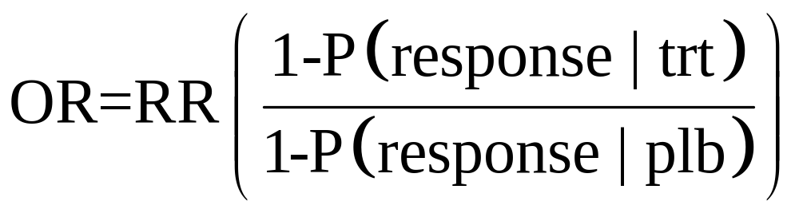
Odds Ratio vs. Relative Risk
The Odds Ratio is NOT mathematically equivalent to the Relative Risk (Risk Ratio)
However, for “rare” events, the Odds ratio can approximate the Relative risk (RR)

Slide 23
Why not use linear regression for dichotomous outcomes?
If we model Y directly and Y is dichotomous, this necessarily violates the linear regression assumptions (homoscedasticity)
One of the more intuitive reasons not to is that will end up with predicted Y’s other than 0 or 1 (possibly more extreme than 0 or 1).

Slide 24
Why not use linear regression for dichotomous outcomes?
Homoscedasticity. This assumption means that the variance around the regression line is the same for all values of the predictor variable (X).
(excerpted from Wikipedia)

Slide 25
Assumptions in logistic regression
Assumptions in logistic regression
  Y_{i} are from Bernoulli or binomial (n_{i}, μ_{i}) distribution
  Y_{i} are independent
  Log odds P(Y_{i} = 1) or logit P(Y_{i} = 1) is a linear function of covariates

Slide 26
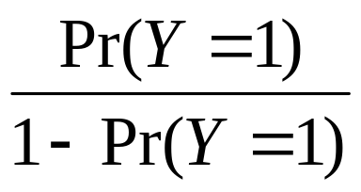
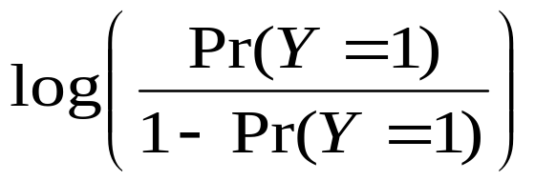
Relationships among probability, odds and log odds
Measure | Min | Max | Name
Pr(Y=1) | 0 | 1 | prob
 | 0 | ∞ | odds
 | -∞ | ∞ | log odds

Slide 27
Commonality between linear and logistic regression
Operating on the logit scale allows a linear model that is similar to linear regression to be applied
Both linear and logistic regression are apart of the family of Generalized Linear Models (GLM)

Slide 28
Logistic Regresion is a
General Linear Model (GLM)
Family of regression models that use the same general framework
Outcome variable determines choice of model
Outcome | GLM Model
Continuous | Linear regression
Dichotomous | Logistic regression
Counts | Poisson regression

Slide 29
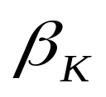
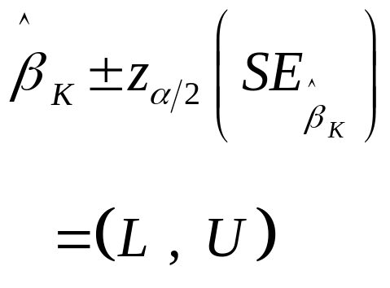
Logistic Regression Models are estimated by Maximum Likelihood
Using this estimation gives model coefficient estimates that are asymptotically consistent, efficient, and normally distributed.
Thus, a 95% Confidence Interval for is given by:
What are SE and z?

Slide 30
Logistic Regression Models are estimated by Maximum Likelihood
Thus, a 95% Confidence Interval for is given by:
What are SE and z_{α/2}?
Quantiles of the standard normal distribution.
α 0.10 0.05 0.025 0.01 0.005 0.001
z_{α} 1.28 1.64 1.96 2.33 2.58 3.09

Slide 31
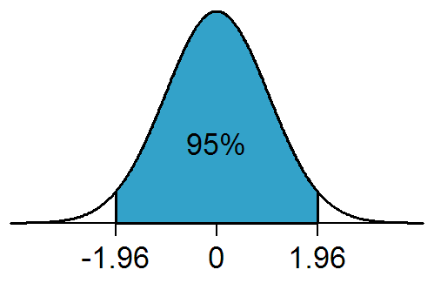
Alpha=0.025, Z=1.96

Slide 32
The Logistic Regression Model
Example:
In Assisted Reproduction Technology (ART) clinics, one of the main outcomes is clinical pregnancy.
There is much empirical evidence that the candidate mother’s age is a significant factor that affects the chances of pregnancy success.
A recent study examined the effect of the mother’s age, along with clinical characteristics, on the odds of pregnancy success on the first ART attempt.

Slide 33
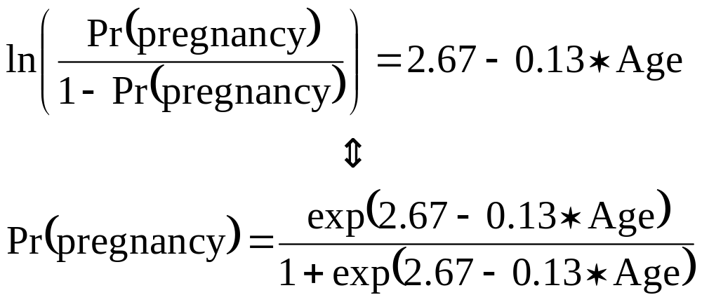
The Logistic Regression Model

Slide 34
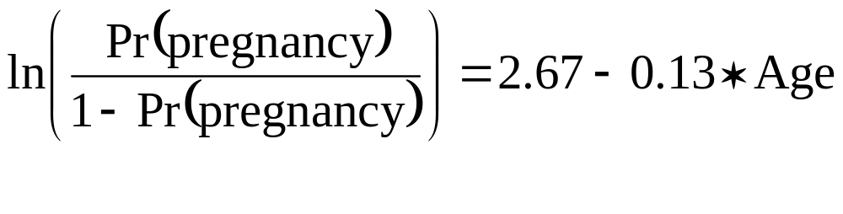
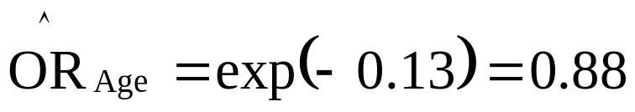
The Logistic Regression Model
Q1. What is the effect of Age on Pregnancy?
A. The
This implies that for every 1 yr. increase in age, the odds of pregnancy decrease by 12%.

Slide 35
The Logistic Regression Model
Q2. What is the predicted probability of a 25 yr. old having pregnancy success with first ART attempt?

Slide 36
The Logistic Regression Model

Slide 37
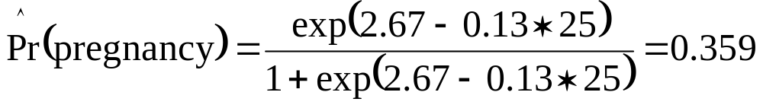
The Logistic Regression Model
Q2. What is the predicted probability of a 25 yr. old having pregnancy success with first ART attempt?
A. From this model, a 25 yr. old has about a 36% chance of pregnancy success.

Slide 38
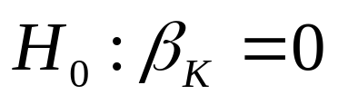
Hypothesis testing
Usually interested in testing
Two types of tests we’ll discuss:
        Likelihood Ratio test
        Wald test

Slide 39

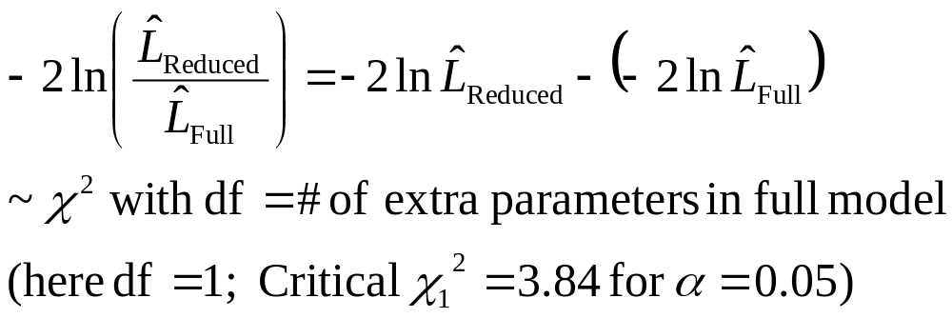
Likelihood Ratio test
Idea is to compare the (log) Likelihood of two models to test
Two models:
        Full model = with predictor included
        Reduced model = without predictor
Then,

